Slide 1
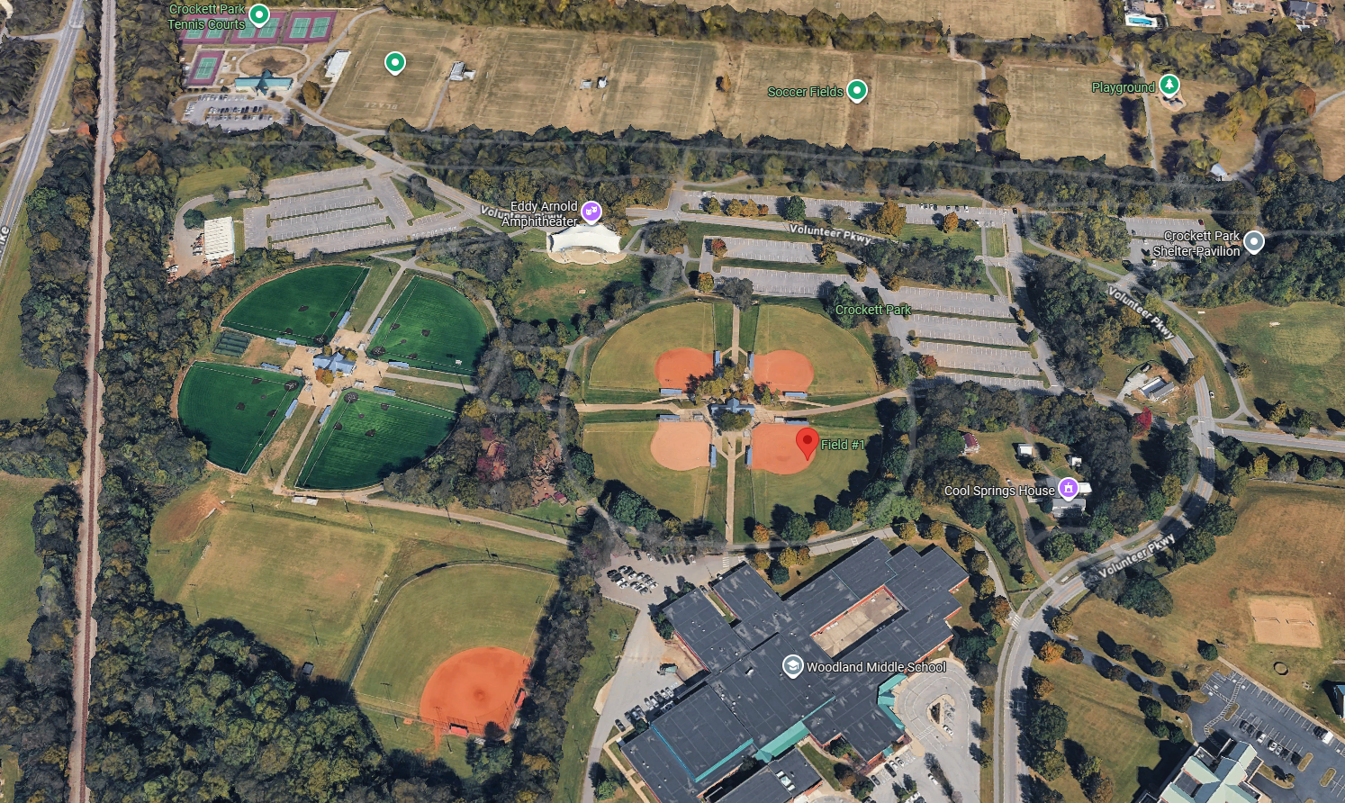
Tennis Courts
CROCKETT PARK
(1500 Volunteer Pkwy)
Football Fields
Soccer Fields
AED
Amphitheater
4 Batting Cages
Field 8
Field 5
Field 3
Field 4
AED
Field 7
Field 6
Field 1
Field 2
Concession Stand
WMS Field
Woodland Middle School

Slide 2
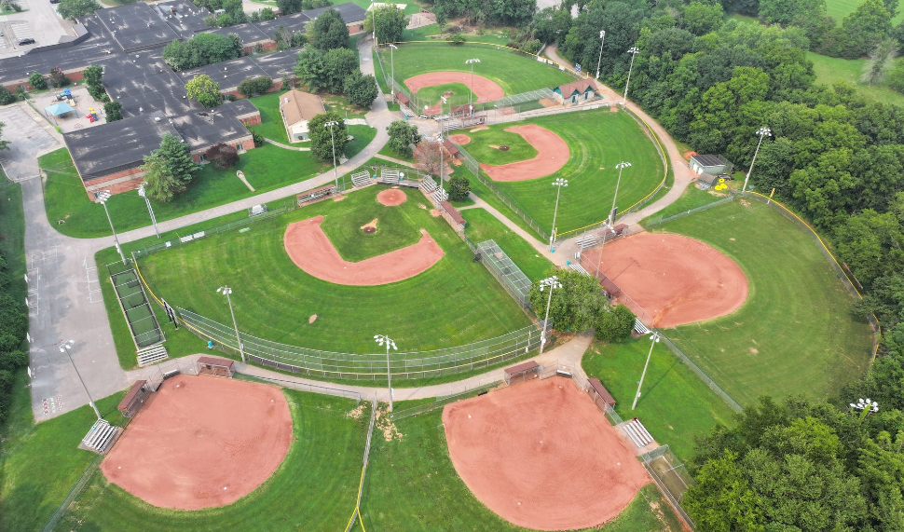
CIVITAN PARK
(8013 Concord Rd)
Lipscomb Elementary School
Field 1
Pitching Cages
Field 2
Field 3
Field 6
Batting Cages
Field 5
Field 4

Slide 3
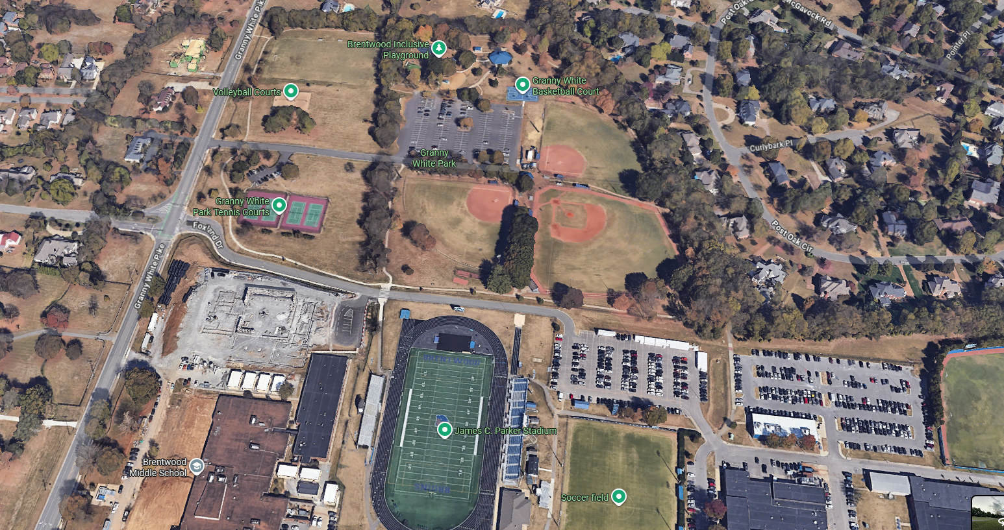
GRANNY WHITE PARK
(610 Granny White Pike)
Field 1
Field 3
Field 2
Brentwood Middle School
Brentwood High School

